Slide 1
My Sun Project
By Aaron Walsh
2nd Hour Earth Science

Slide 2
Extra Information
For this project, I walked over to the Sparrow Hospital Parking garage, then walked to the western ledge.
I took the picture with the Lansing skyline as the background
Being about 80 feet above the ground, one can see quite a lot up there (see end of the Powerpoint for extra pictures.

Slide 3
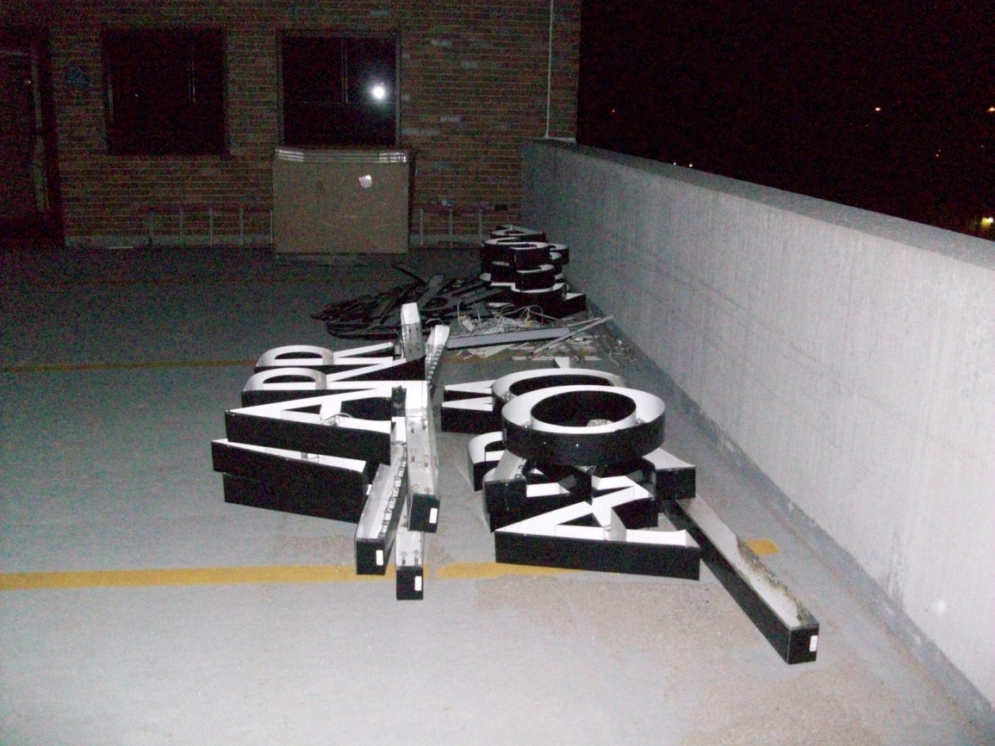
Extra Information (Continued)
While doing this project, Sparrow changed their logo… and left the lettering for the old logos that were dotted about the hospital in the corner where I stand to take my picture

Slide 4
Extra Information (Continued)
Still, I had to step through it and even move it. About a week before the end of the project, the lettering was finally moved.
Ever since starting this project back in February, I now walk over to Sparrow nearly every day.

Slide 5
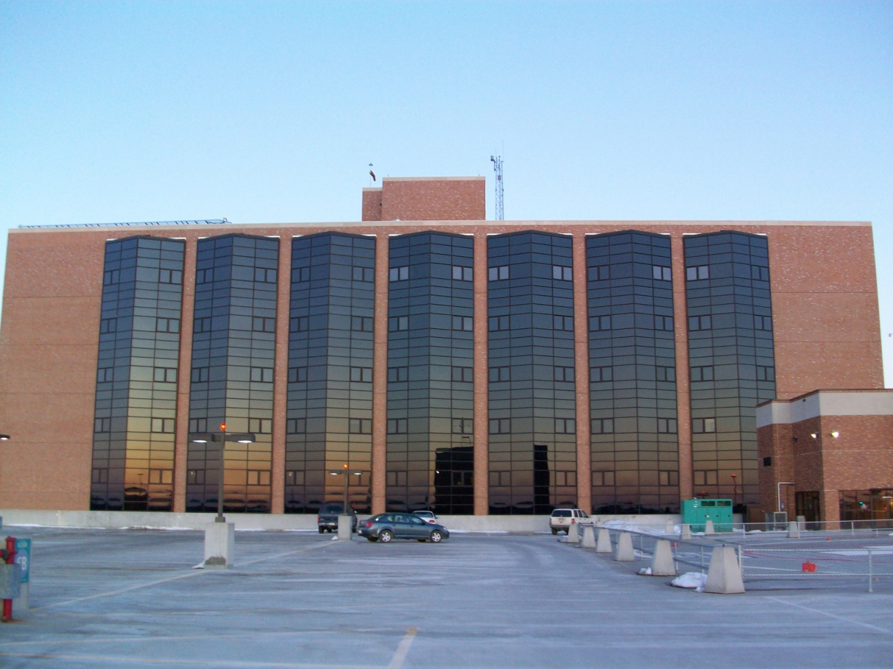
Parking garage overview
The parking garage is so massive, that it’s essentially walking two blocks when going over to the ledge and back.

Slide 6
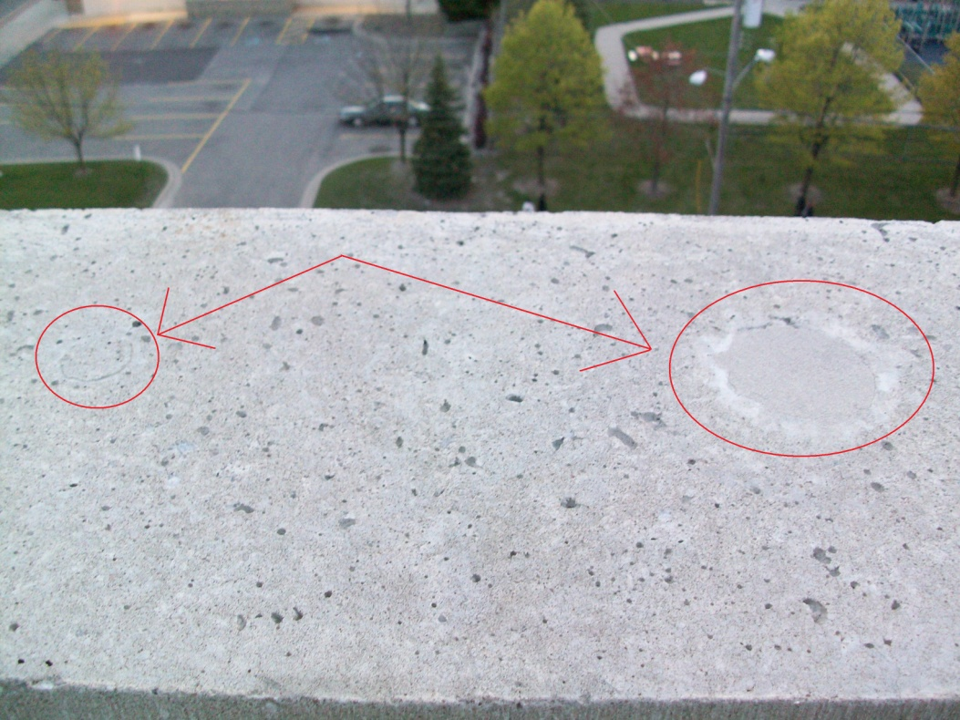
Extra Information (Continued)
While the pictures may not be the exact same, I used a cement hole that was filled in for a reference as to where to stand. I always used the third one over from the left, which had a smaller hole next to it.

Slide 7
More to know
Up until the last picture taken for the project, the sun was setting behind the skyscrapers downtown, so I had to take the pictures about 5 minutes before the actual time of the sunset.

Slide 8
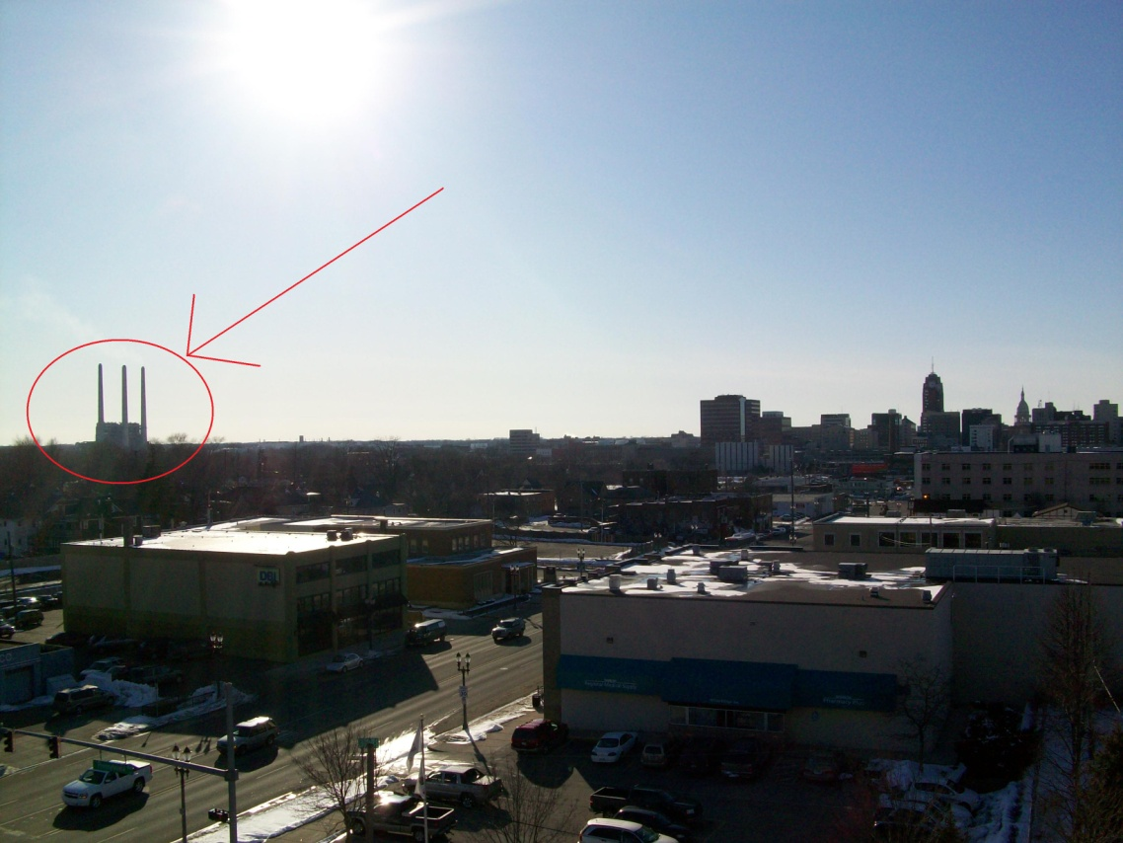
More to know (Continued)
Initially, I had planned on using a view with the Otto Eckert Power Plant in it.

Slide 9
More to know (continued)
Not a month into the project, the location along the horizon that the sun would set moved out of the picture.

Slide 10
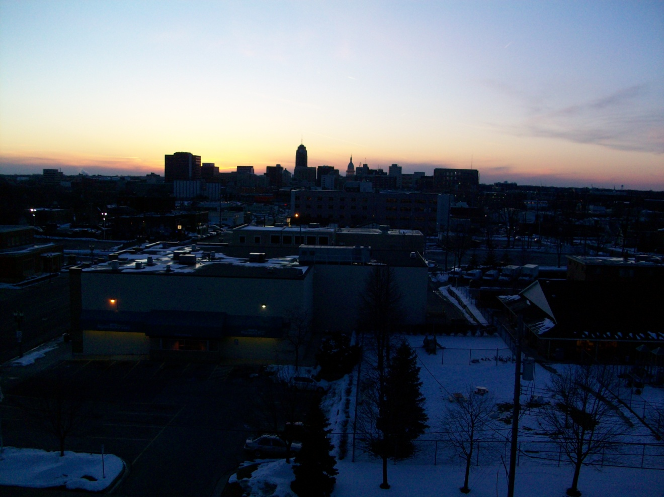
Friday, February 19th, 2010
(6:15 PM Eastern Standard Time)

Slide 11
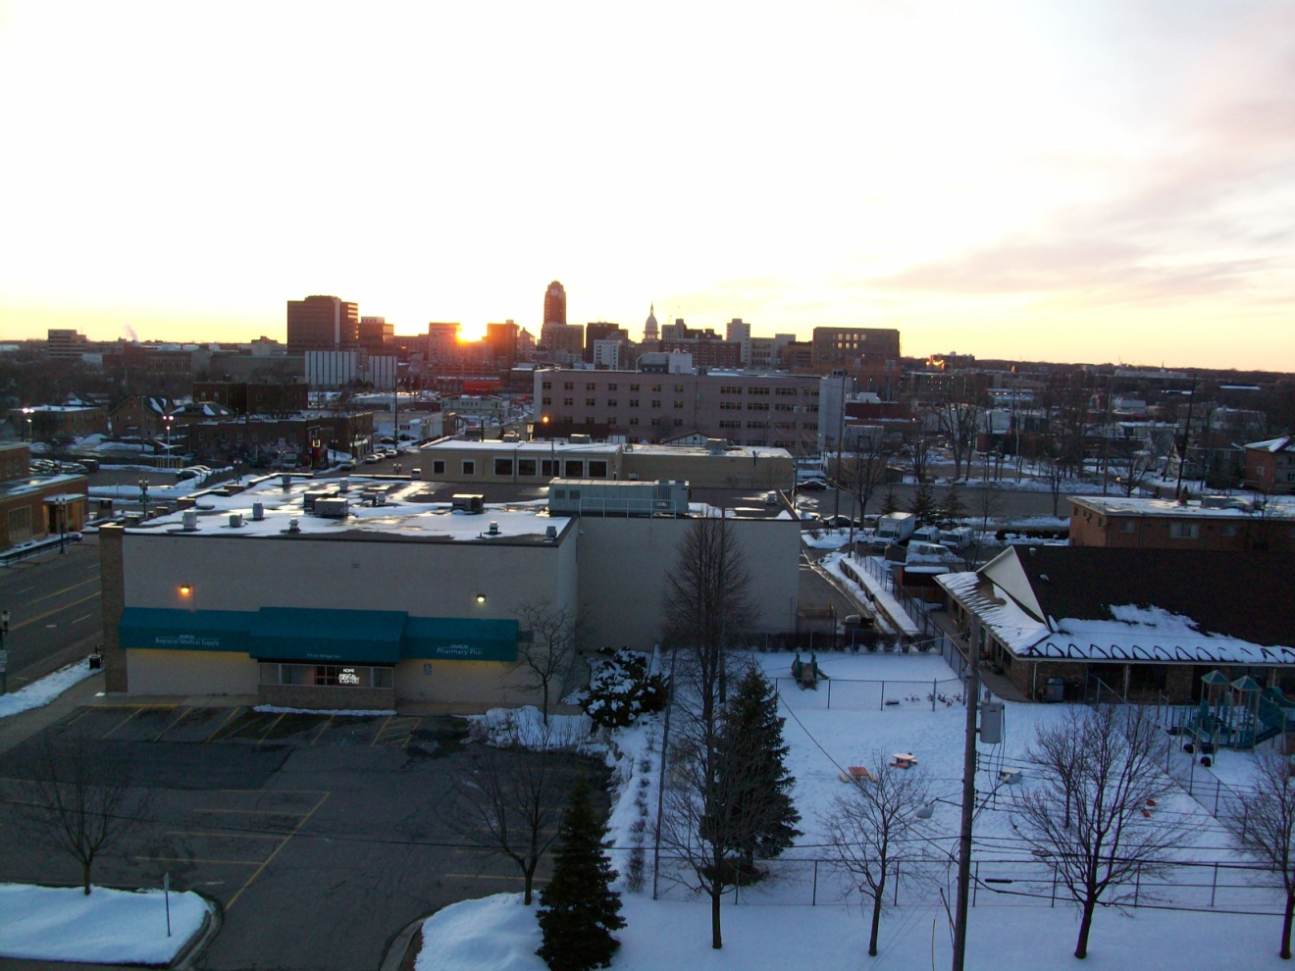
Saturday, March 1st, 2010
(6:27 PM Eastern Standard Time)

Slide 12
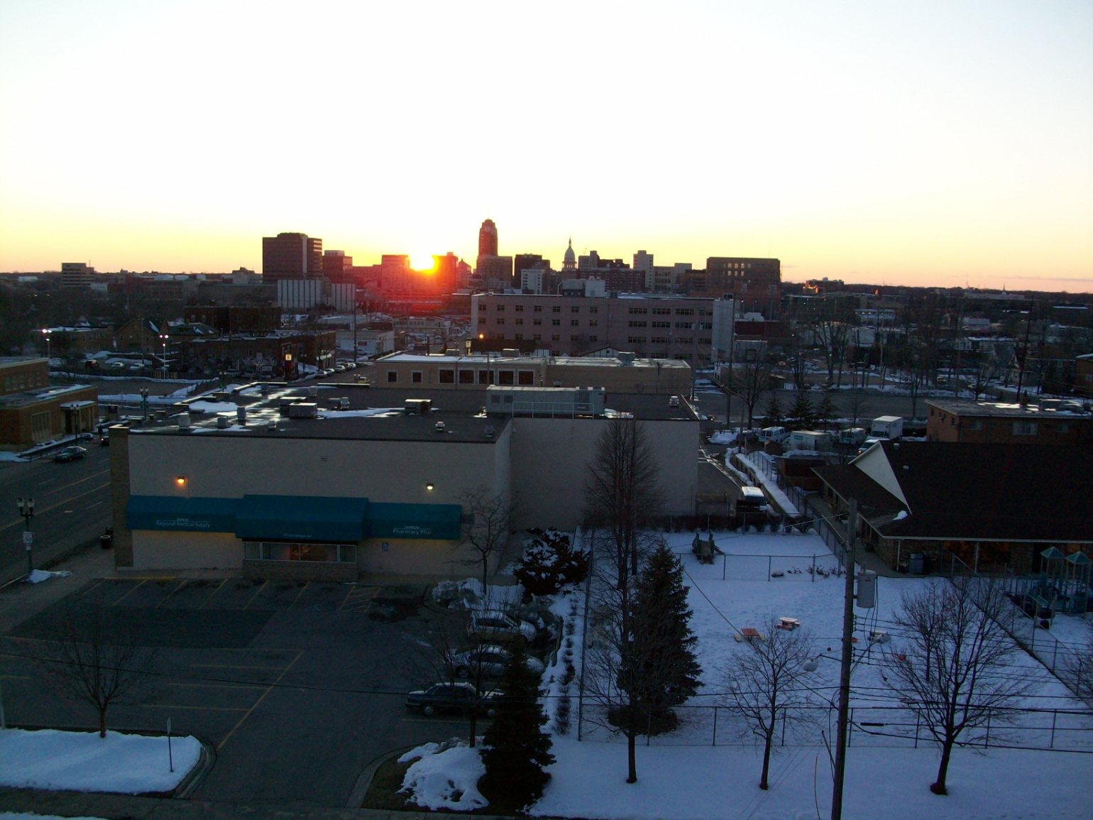
Tuesday, March 4th, 2010
(6:31 PM Eastern Standard Time)

Slide 13
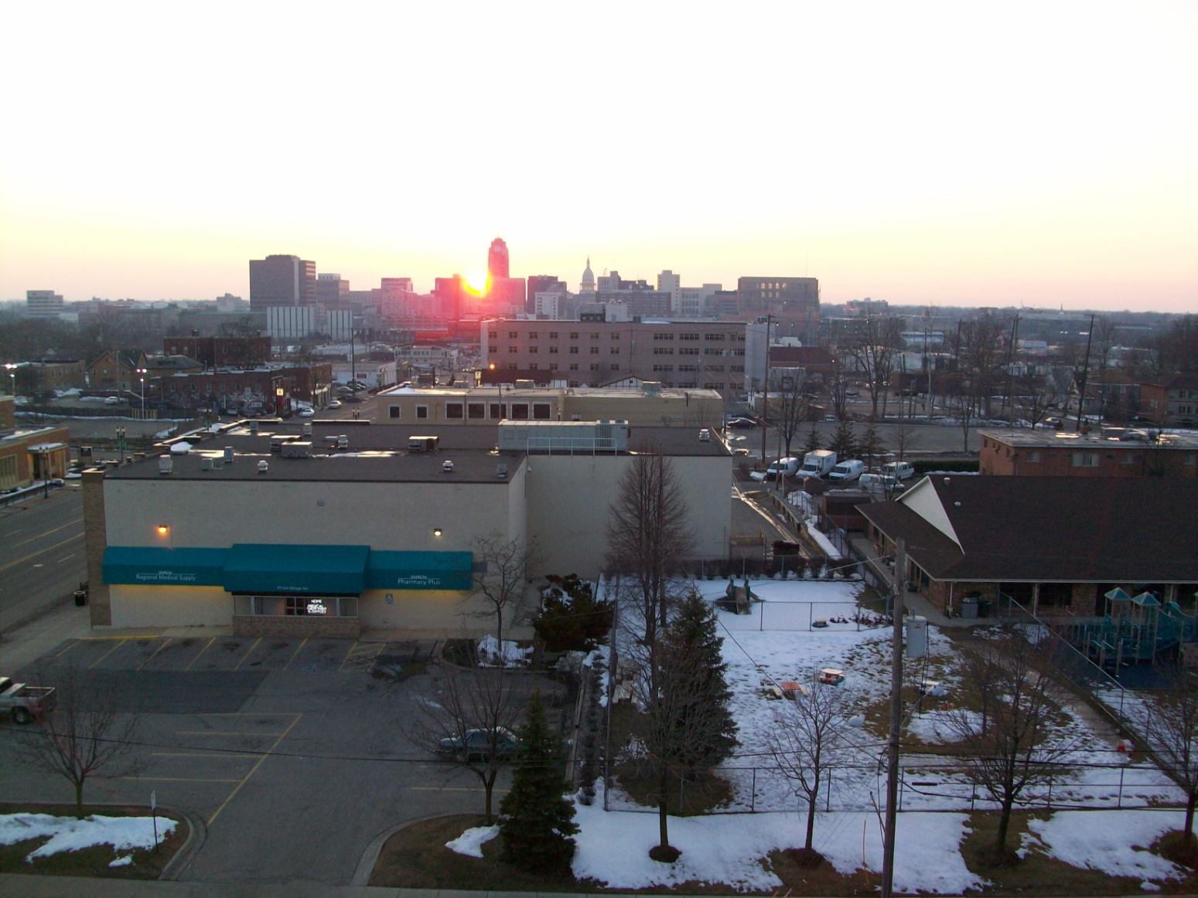
Saturday, March 8th, 2010
(6:35 PM Eastern Standard Time)

Slide 14
More to know
At 2:00 AM ET the morning of Sunday, March 14th, we switched our clocks ahead an hour. Subsequently, this meant that both sunrise and sunset were an hour later. Instead of going over to Sparrow just before 7:00 in the evening, I had to wait until 7:30.

Slide 15
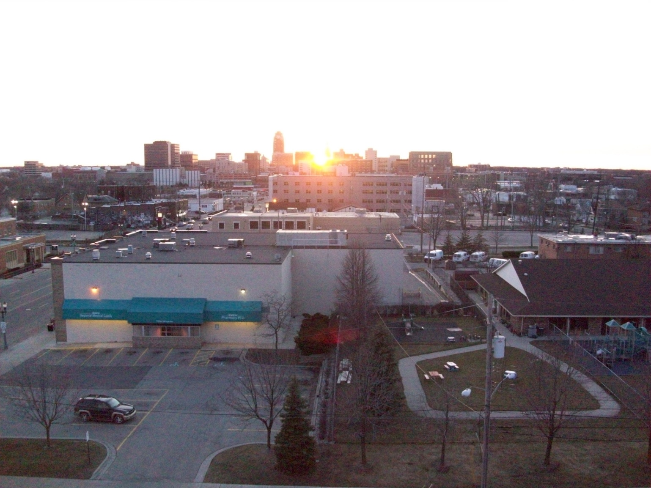
Monday, March 15th, 2010
(7:45 PM Eastern Daylight Time)

Slide 16
Additional information
On Saint Patrick’s day, the weather was once again phenomenal. However, on that day, the sun appeared to be setting directly behind the state capitol (from the spot where I would stand), and you could see it shining through the capitol.

Slide 17
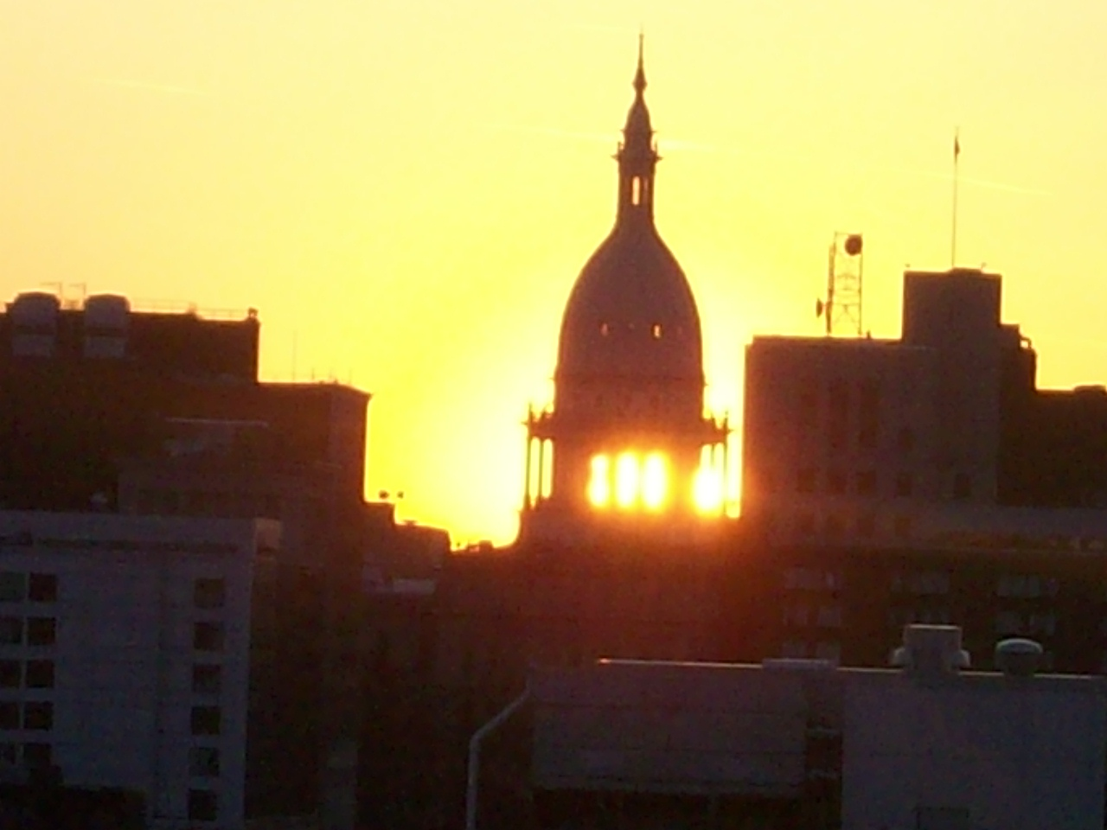

Slide 18
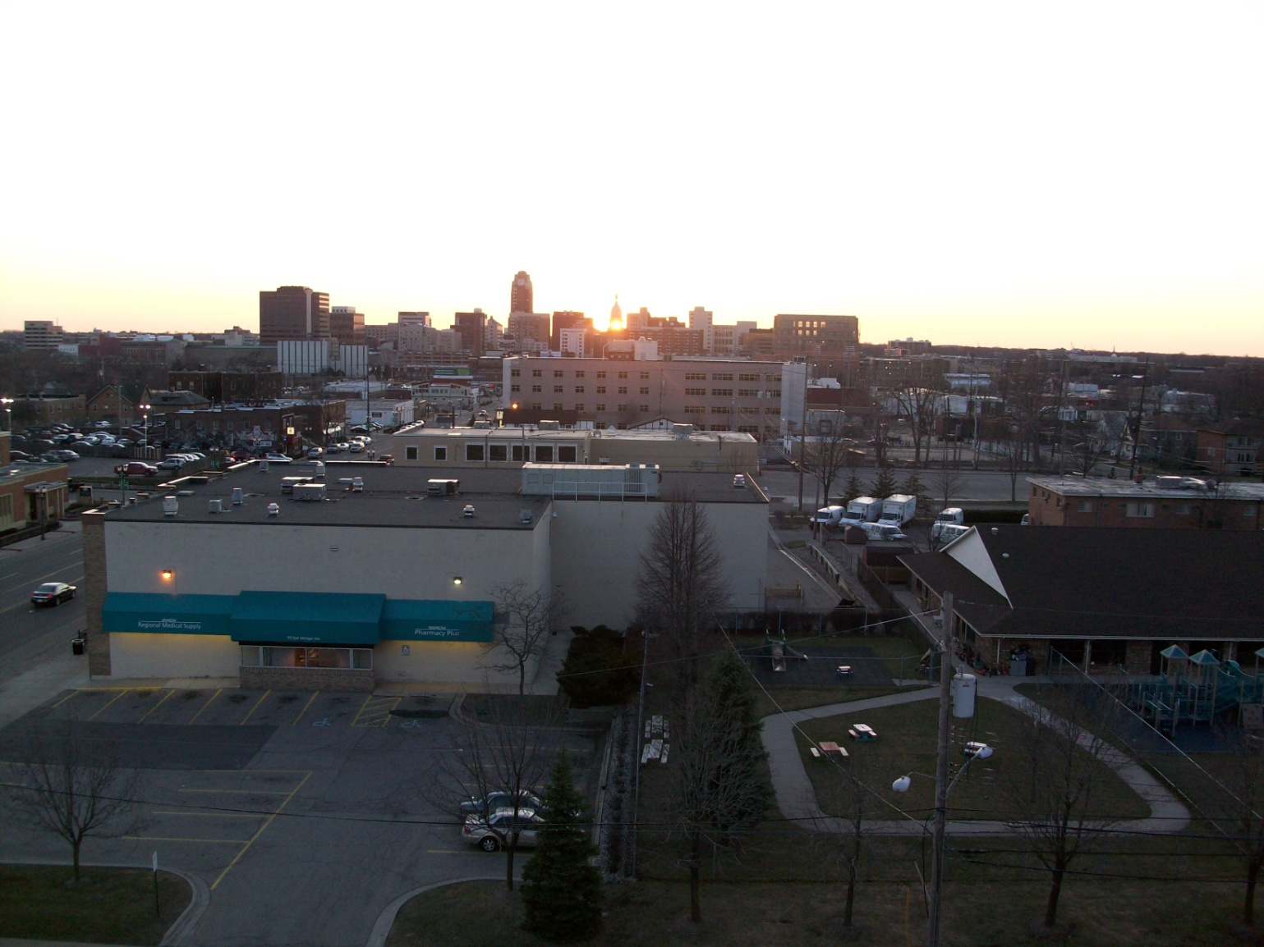
Wednesday, March 17th, 2010 (St Patrick’s Day)
(7:46 PM Eastern Daylight Time)

Slide 19
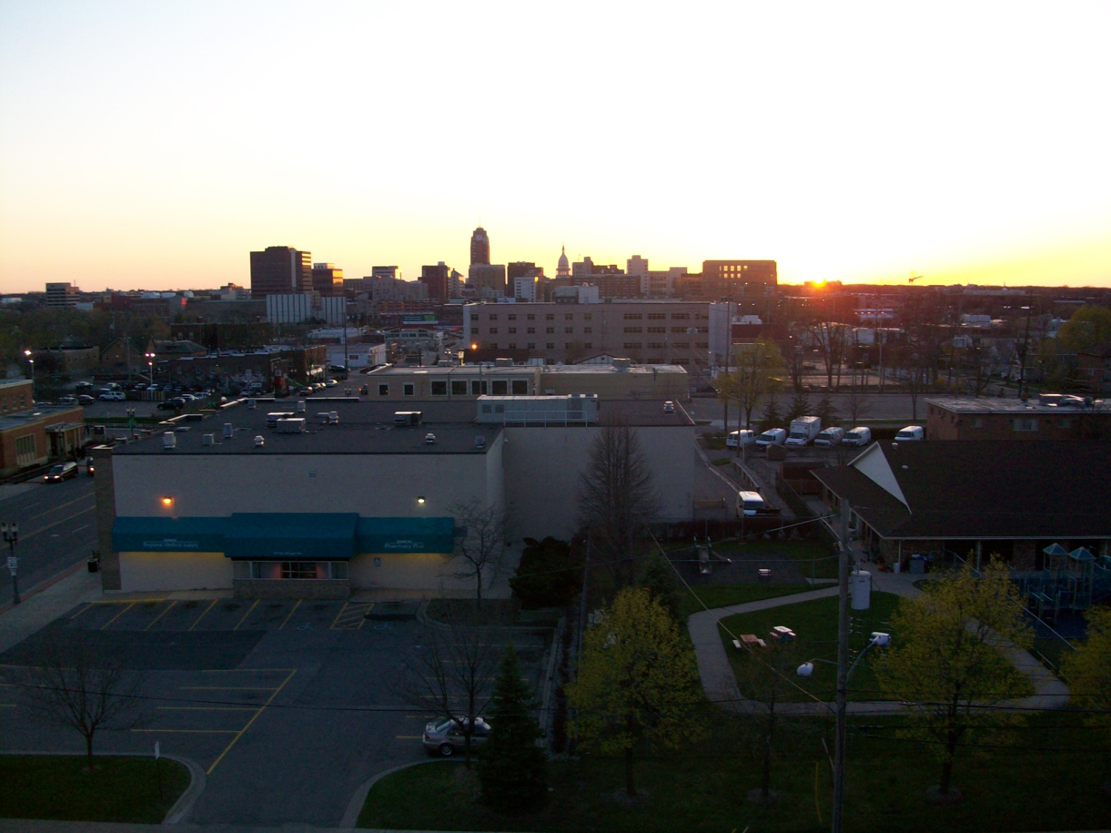
Friday, April 9th, 2010
(8:12 PM Eastern Daylight Time)

Slide 20
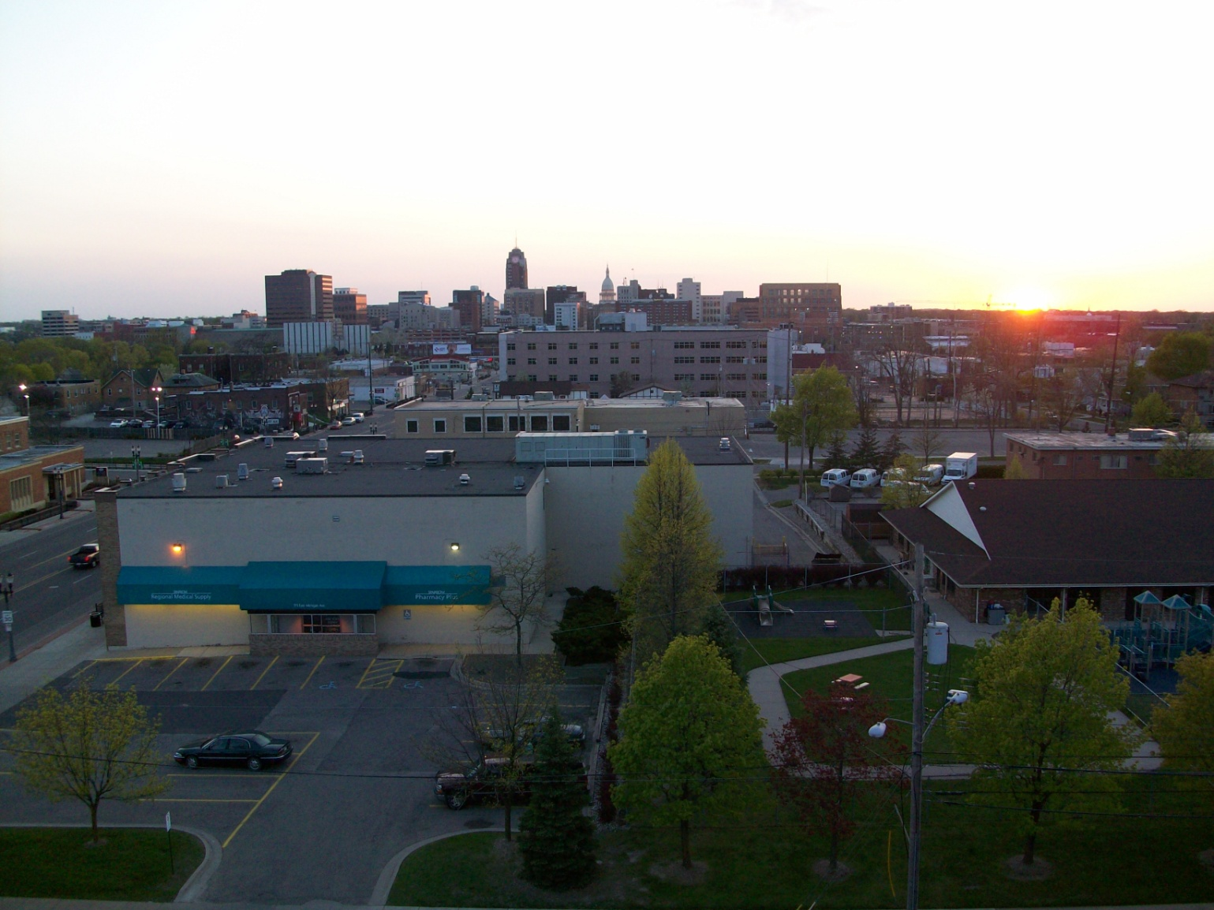
Thursday, April 22nd, 2010 (Earth Day)
(8:28 PM Eastern Daylight Time)

Slide 21
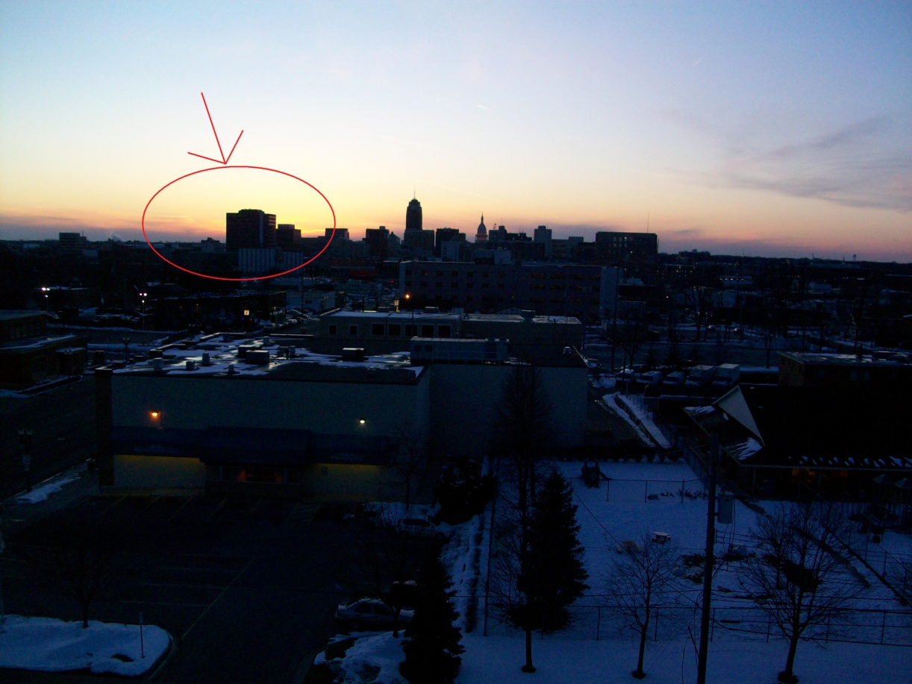
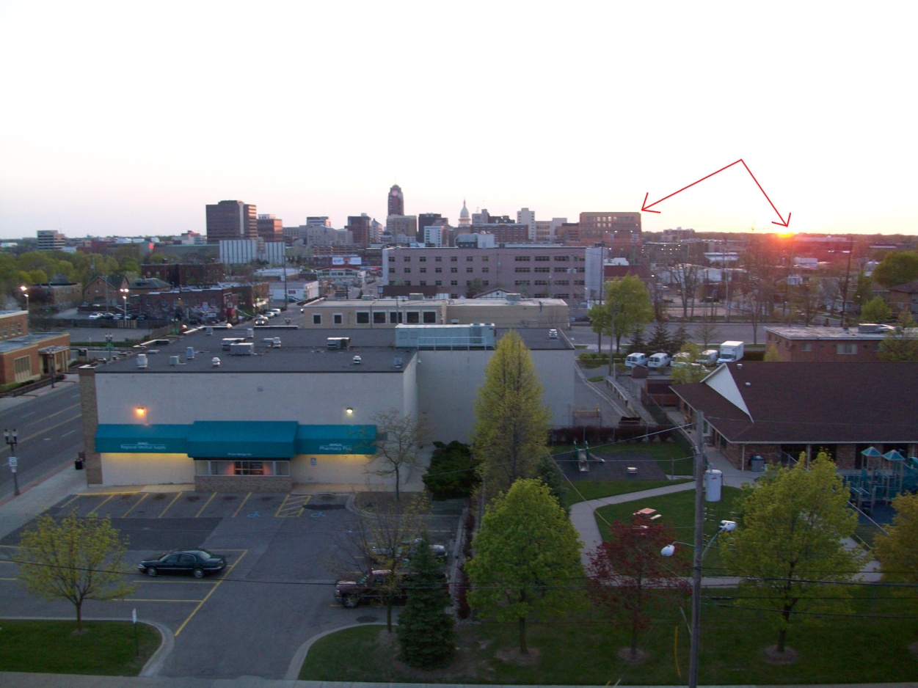

Slide 22
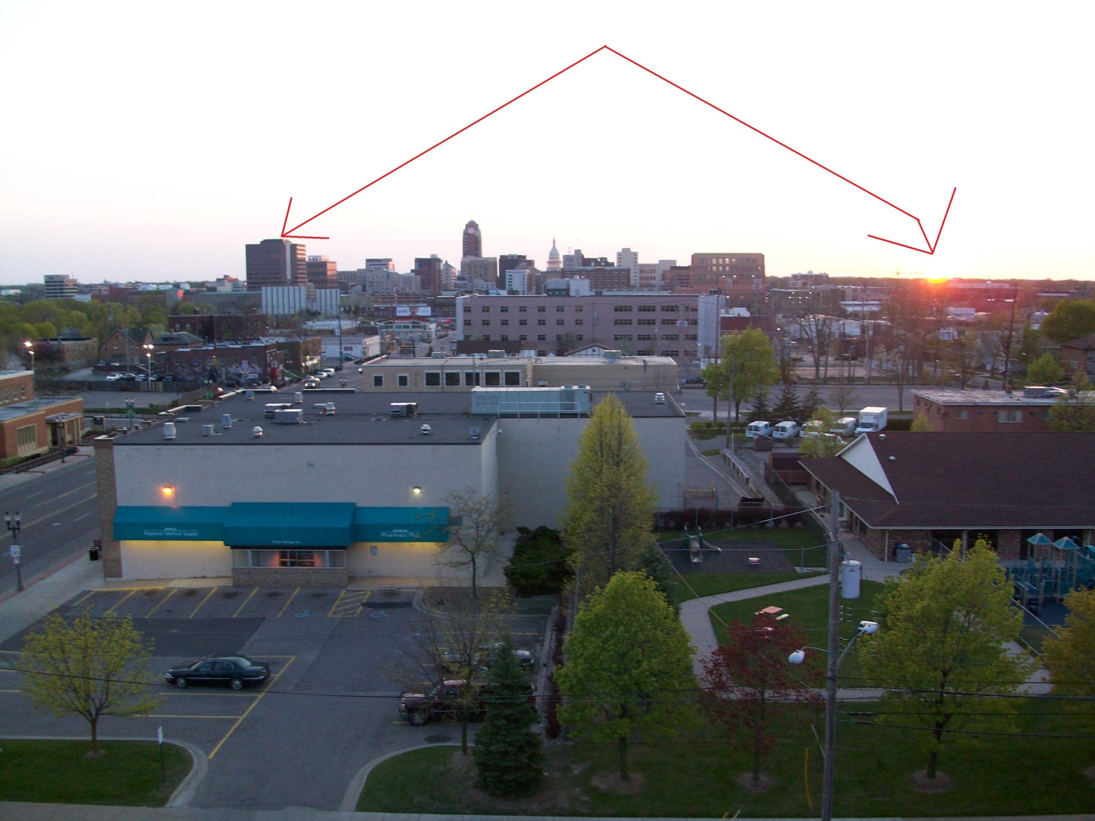
Here’s a picture showing the change of the position of the sunset all the way across the horizon. At the start of the project back in February, the sun set behind the State Police Building (pointed to on the left). During the final picture, it is near all the way to the right in the frame.

Slide 23
2) How did ancient civilizations use the information in these pictures?
In ancient times, before the Gregorian Calendar we know now, ancient civilizations would use the position of the sun in the sky to tell what time it was.
They used the location of the sun when it would rise or set to tell roughly what time of year it was. To this day, that can still be done.

Slide 24
3) How does the position of the sunrise or sunset lead to warmer summers or cooler winters?
The angle of the sun on the horizon has everything to do with the temperature. A more direct sunlight makes the weather much warmer. During the winter, the sun is at a much lower angle in the sky, which is why the winter is always the colder season. During the summer, the sun is more overhead… and the summer is always warmer.

Slide 25
4) How might you expect the location of the sunset to change 6 months from now? Would it “move” in the same direction?
The position of the sun along the horizon is affected by the season. On Winter Solstice, the sun is at the lowest possible angle along the horizon. On Summer Solstice, the sun is at the highest possible angle along the horizon. The sun is still moving along the horizon, and will continue to do so through the first day of summer in June. 6 months from now, the sun would most likely set behind the State Police Headquarters, where it initially began for this project (since October and February are both 2 months part from Winter Solstice).

Slide 26
5) Why is “move”, in the previous question, in quotations?
The sun does not actually move. The movement we see is called “apparent movement”, since the sun appears to be moving.
In actuality, the Earth is rotating about the sun constantly
The Earth also changes tilt, along an axis. During the Winter Solstice, the sun is pointed at the southern Hemisphere. During the summer solstice, it is directed at the northern Hemisphere.

Slide 27
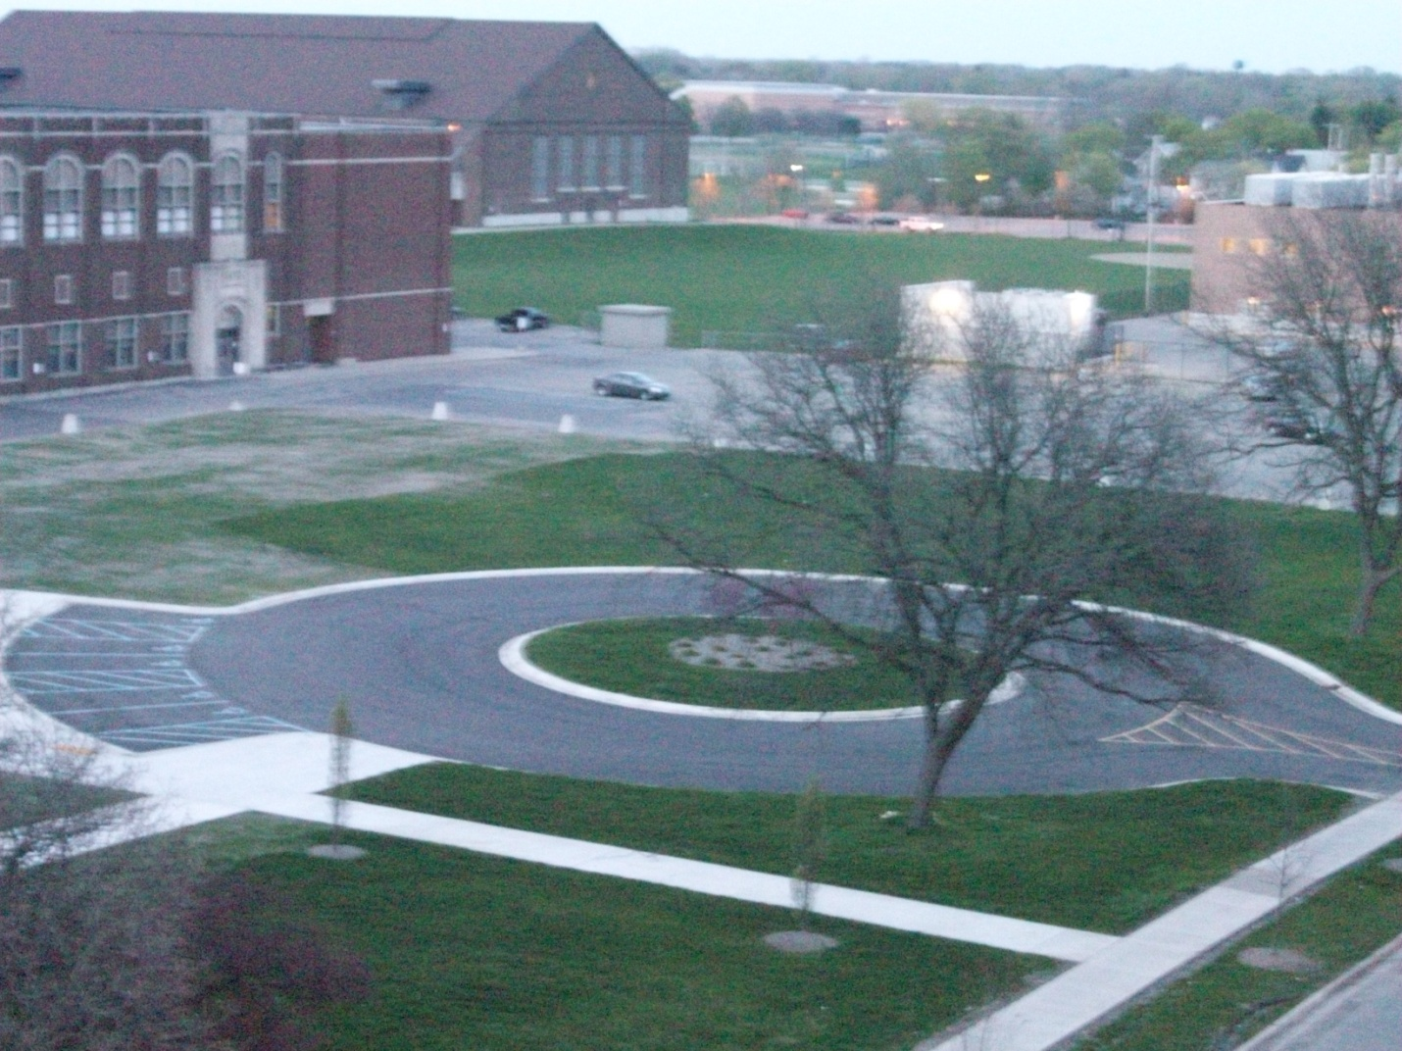
More pictures
Pattengill Middle School (old site in the foreground, current site towards the back center).

Slide 28
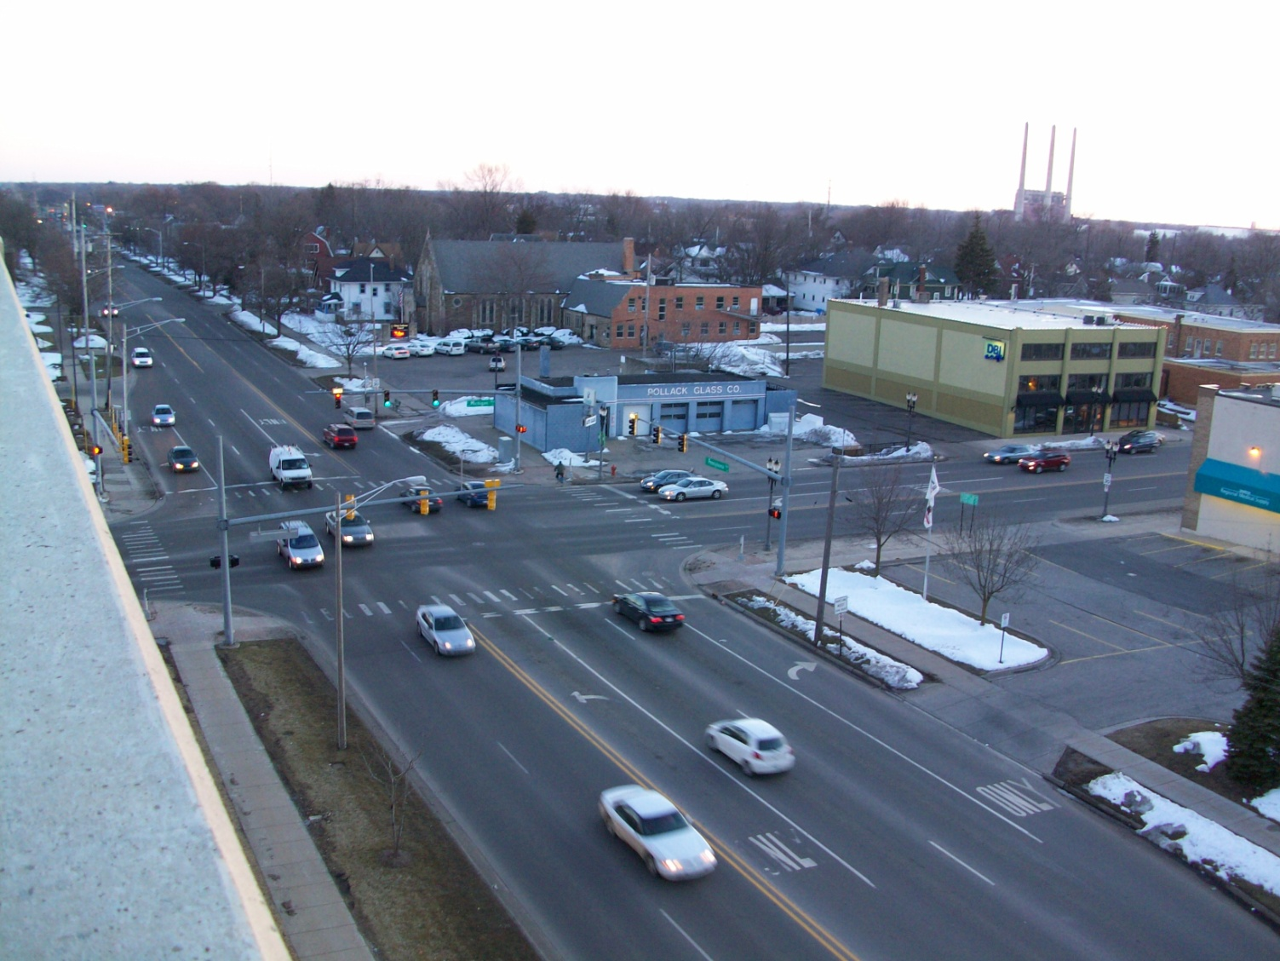
The intersection of Pennsylvania Avenue and Michigan Avenue (as seen from the parking garage)

Slide 29
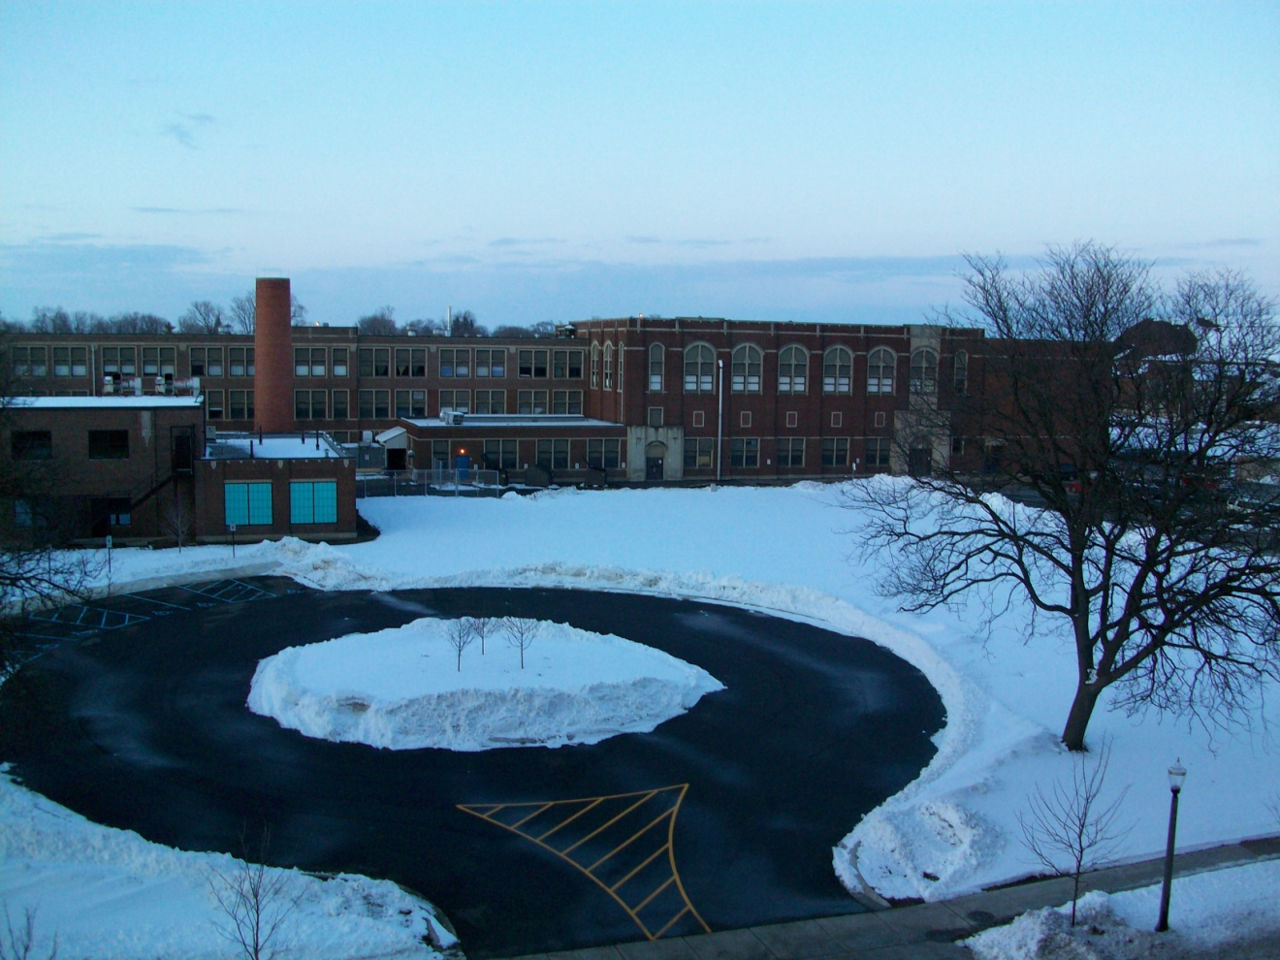
Pattengill Middle School
The former site covered in snow

Slide 30
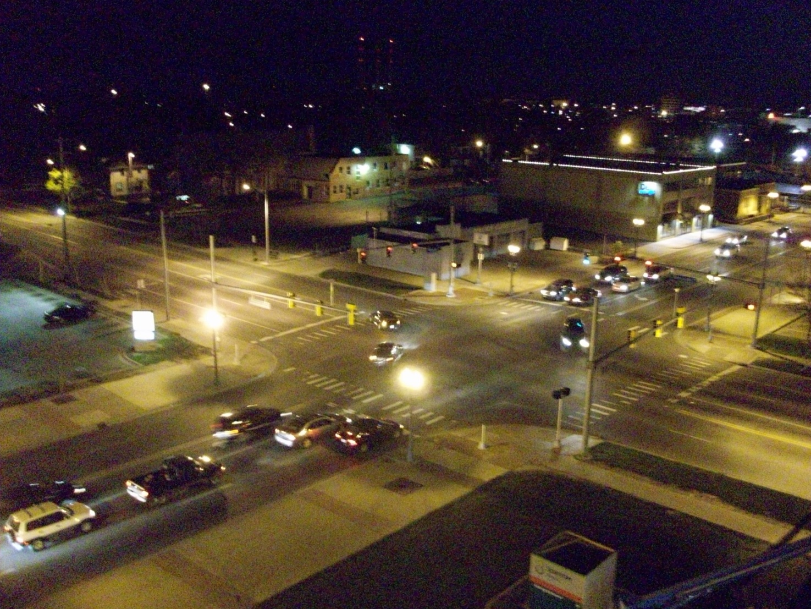
The intersection of Michigan and Pennsylvania at night

Slide 31
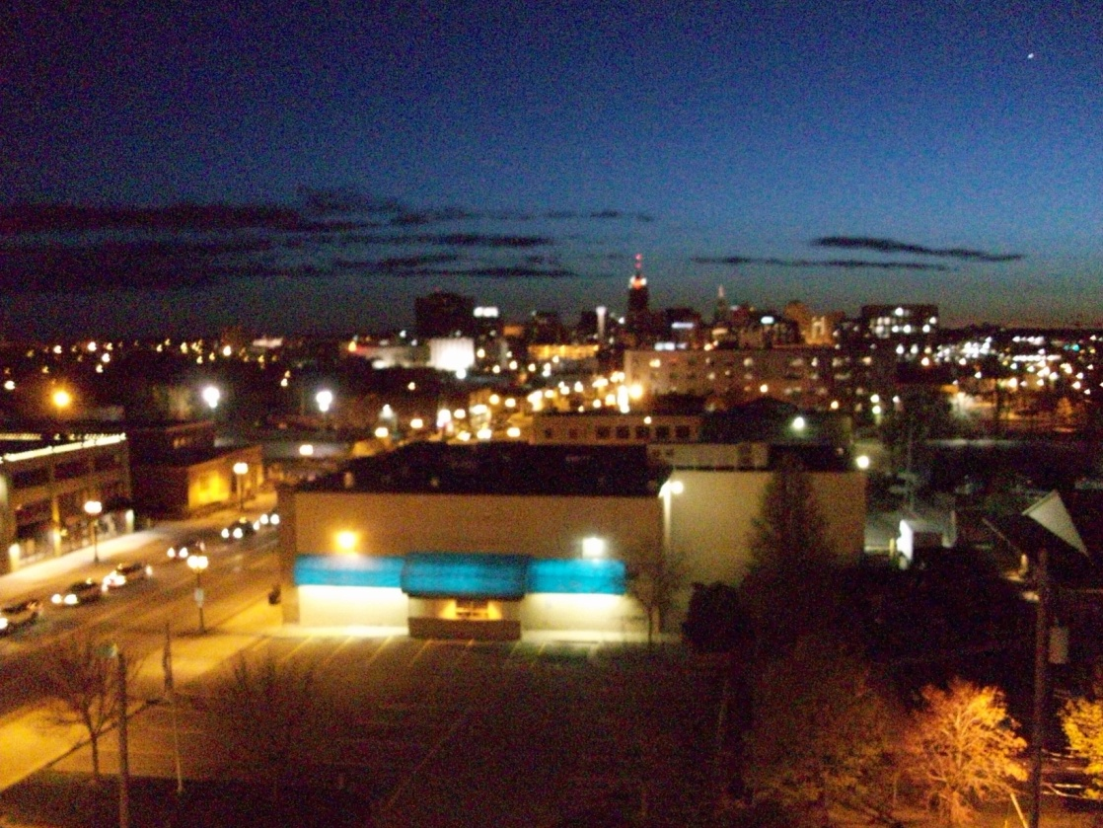
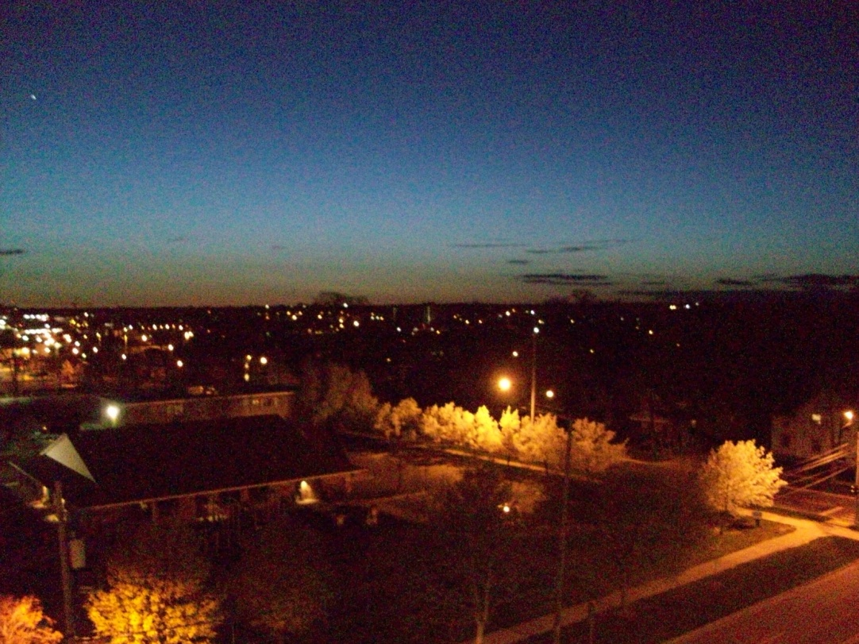
The city at nite…

Slide 32
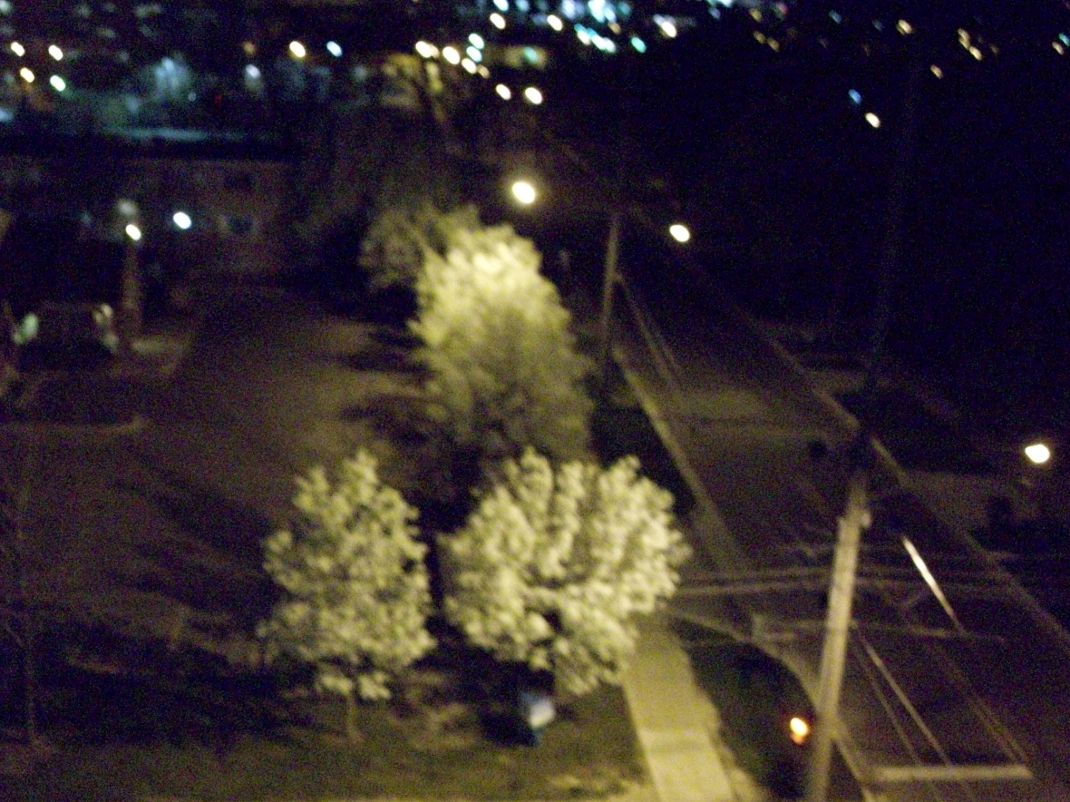
Some “snowy” trees at the Sparrow Daycare Center

